Slide 1
A New Nation
Part 1
The Nation Grows

Slide 2
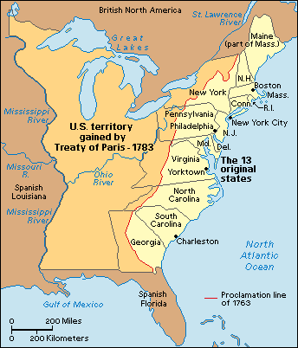
The Treaty of Paris (1783) gave the new United States control of the land west of the original 13 states to the Mississippi River.

Slide 3
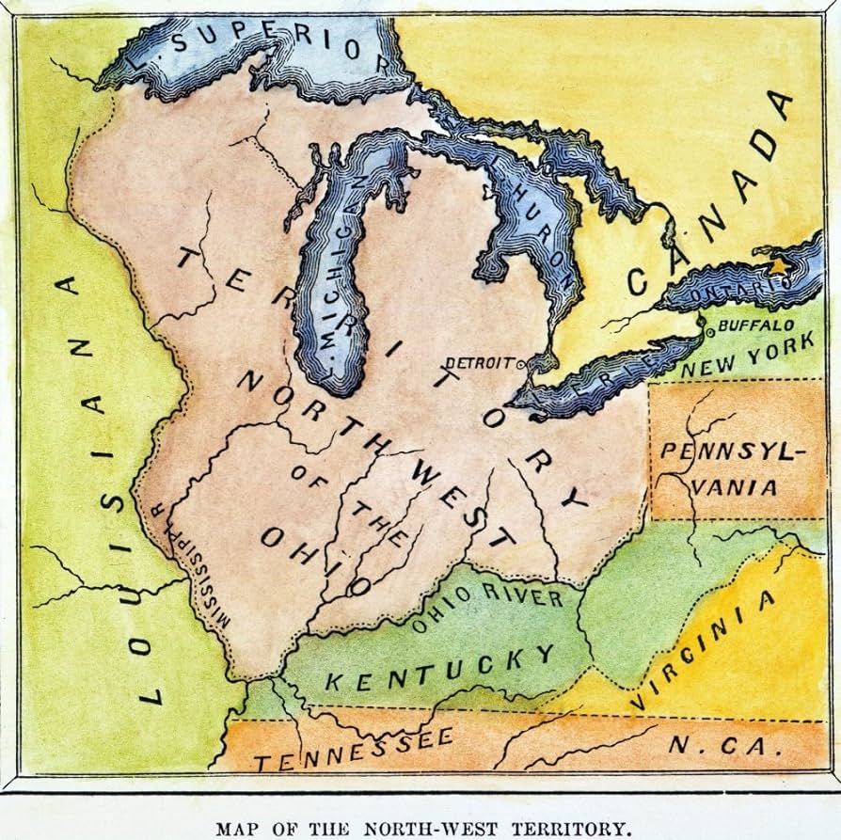
This land north of the Ohio River was called the Northwest Territory.

Slide 4
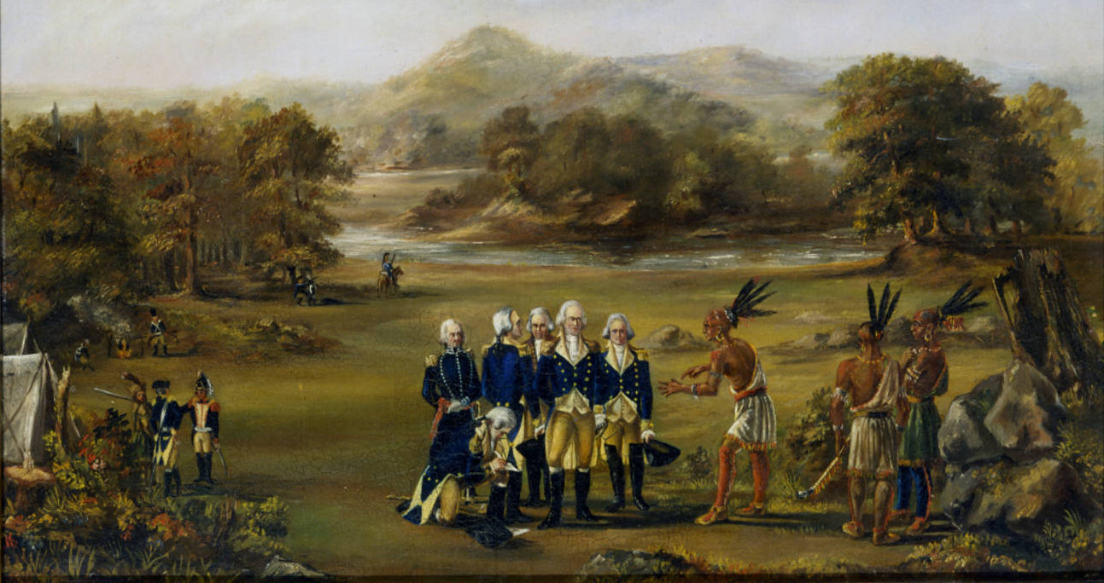
Not many settlers lived there because Native American resistance was strong in that area.

Slide 5
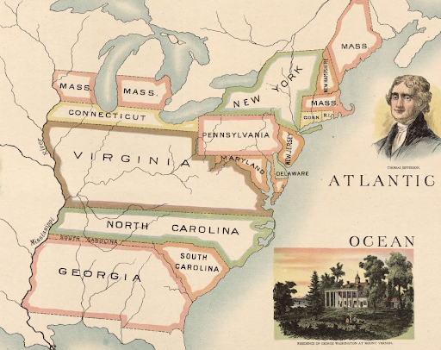
This was also a land of no government, even though several states claimed parts of this land for their states.

Slide 6
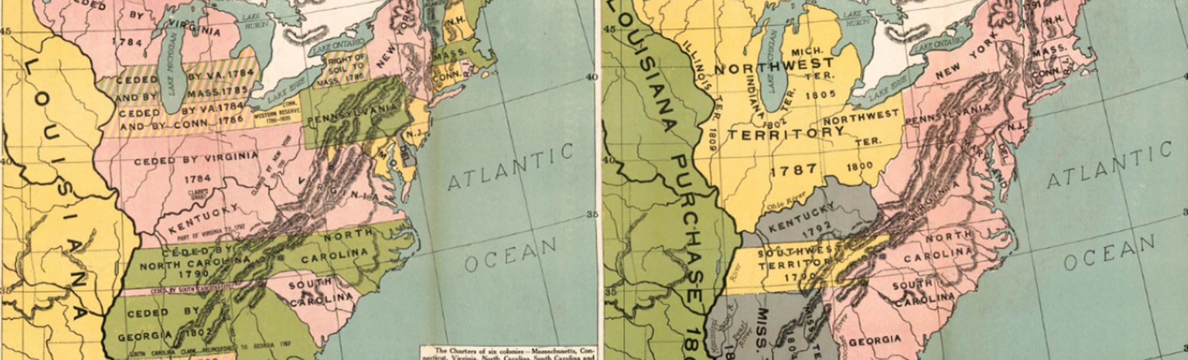
However, to pass the Articles of Confederation, the states that claimed land in the Northwest Territory gave up those claims. This land was now controlled by the national government.

Slide 7
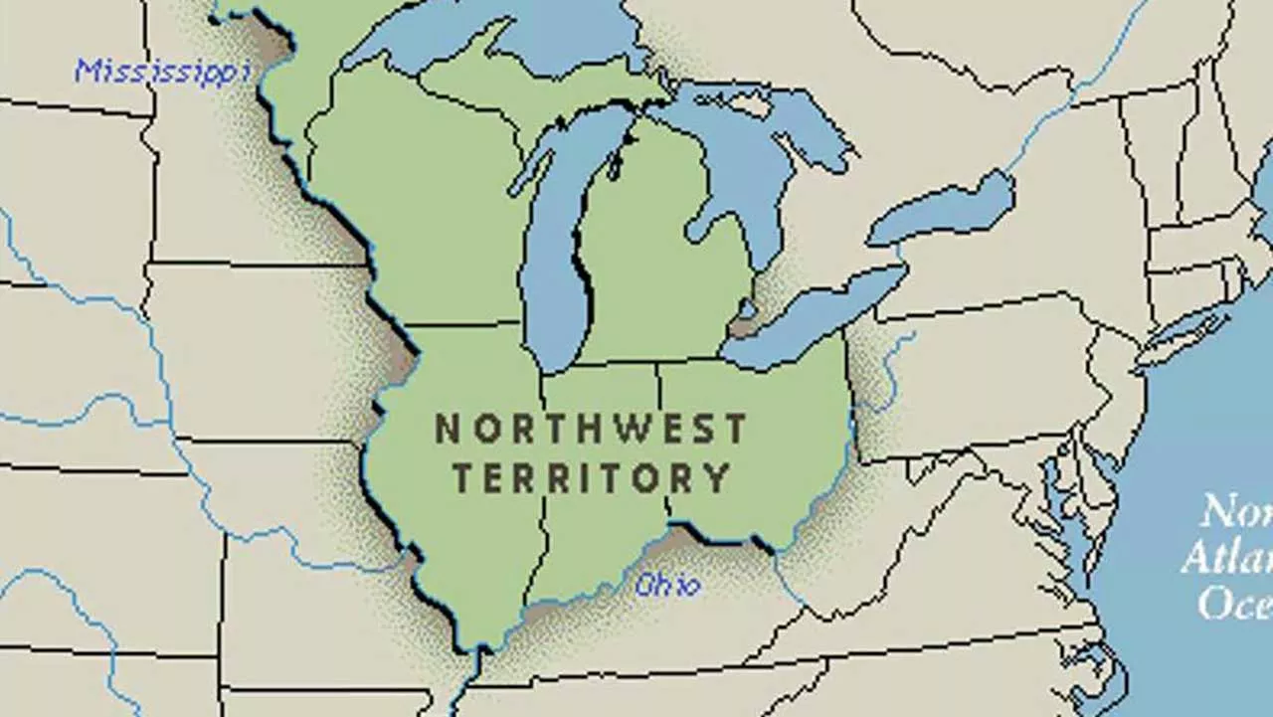
The national government now had to come up with a plan to govern the territory. Like many other issues of the time, there was a variety of ideas and much disagreeing.

Slide 8
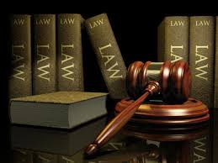
Through the debates on how to handle the Northwest Territory, new government regulations, or ordinances were made.

Slide 9
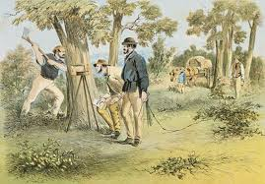
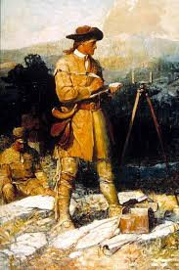
The first ordinance was the Ordinance of 1785. This ordinance called for the land to be surveyed and sold. To survey land means to measure the land to create exact boundaries.

Slide 10
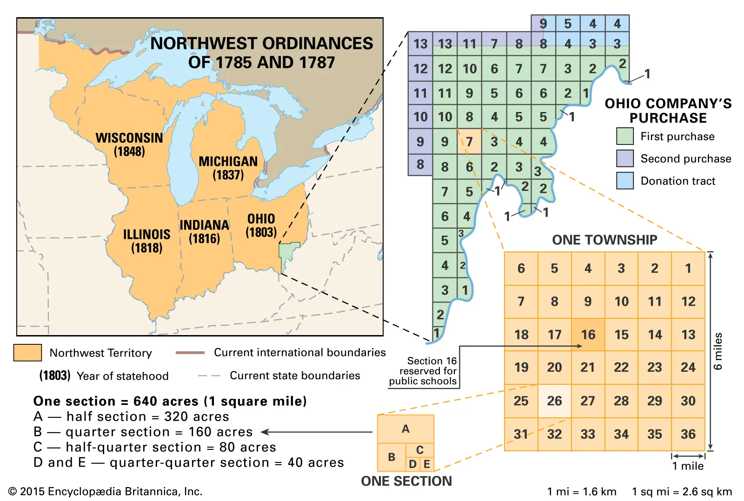

Slide 11
Think About It!
What are some difficulties surveyors might have had in dividing up the land into square lots?

Slide 12
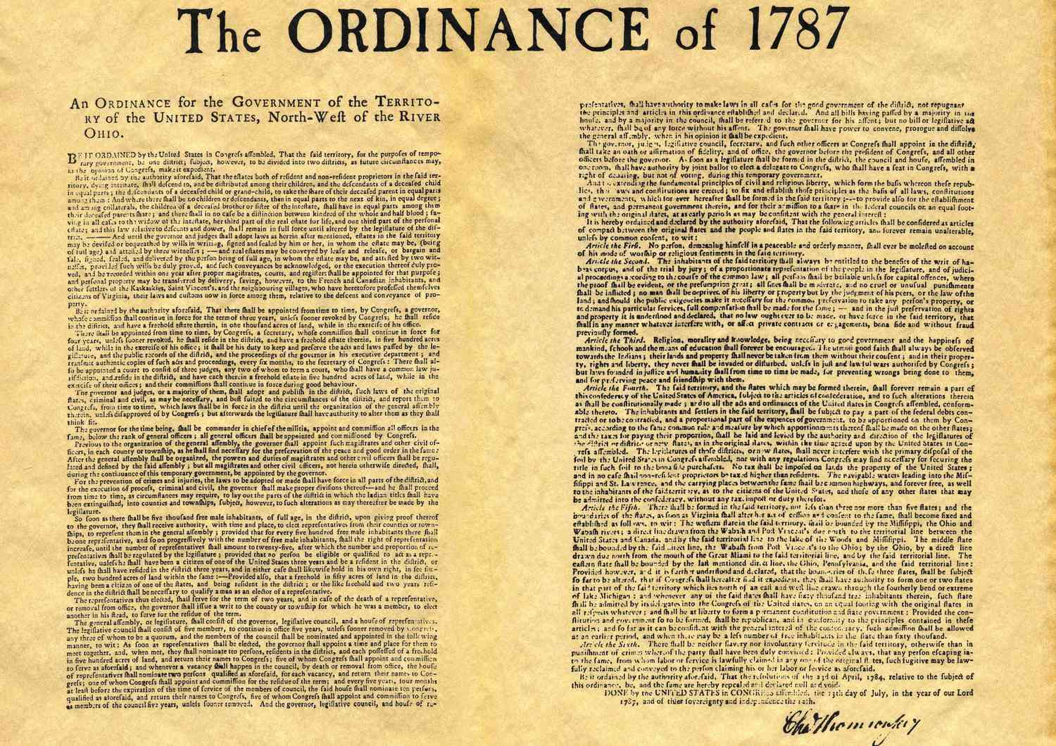
The next ordinance passed was in 1787 and was called the Northwest Ordinance. This ordinance organized how the territory would be governed.

Slide 13
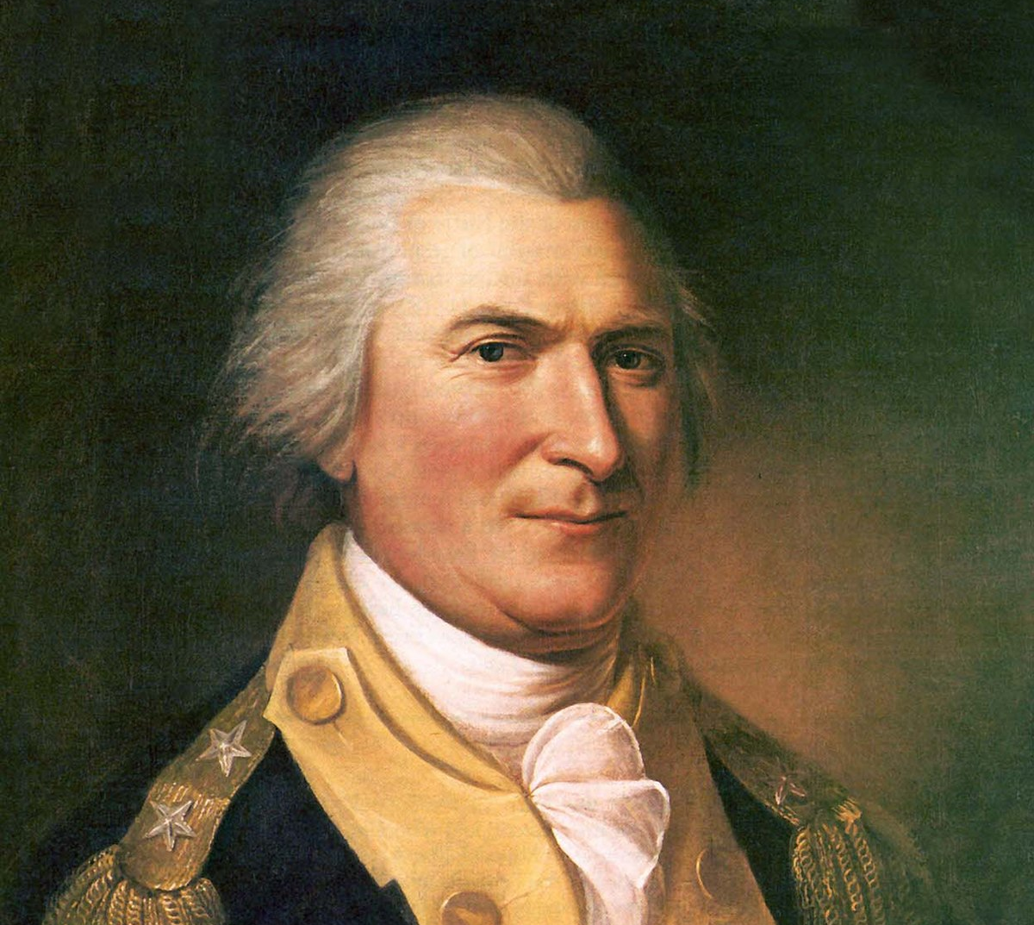
The Northwest Ordinance said that Congress would choose one governor and three judges to oversee the territory.

Slide 14
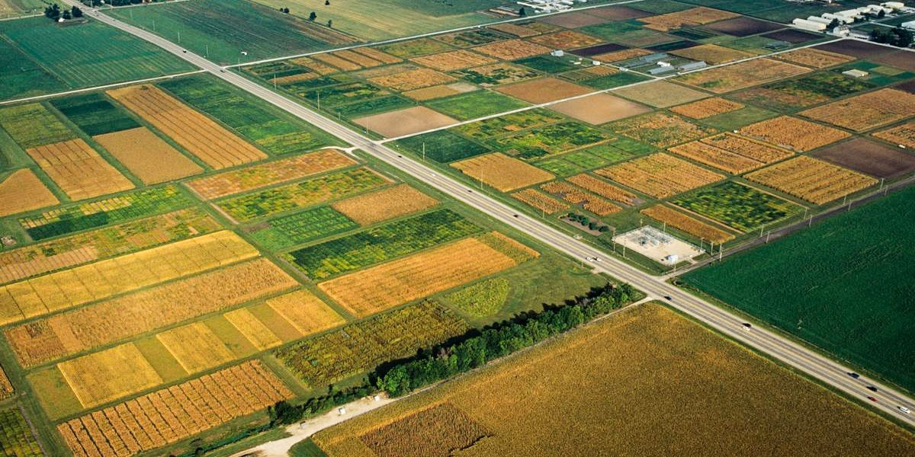
In time, the territory would become between three to five states.

Slide 15
The process included the following steps:
1. 5,000 free men would settle in an area.
2. Those settlers would elect an assembly that would work with the governor and judges.
3. When the territory had 60,000 free citizens, they could ask to join the Union as a state.
4. Congress would vote to admit them as a state.

Slide 16
The Northwest Ordinance stated that when Congress admitted these new states into the nation, they would become a state “on equal footing with the original states in all respects whatsoever.”
What do you think that means, and why is that important?

Slide 17
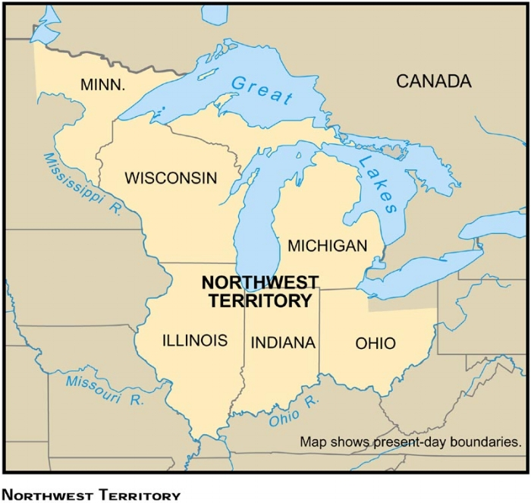
Once settled, the Northwest Territory would become the states of Illinois, Indiana, Michigan, Ohio, and Wisconsin.

Slide 18
The Northwest Ordinance set three other conditions:
1. The citizens of the new territories would have freedom of religion and speech, the right to a trial by jury, and protection from unfair punishments.
2. Settlers had to treat Native Americans fairly.
3. Slavery was banned in the territory.

Slide 19
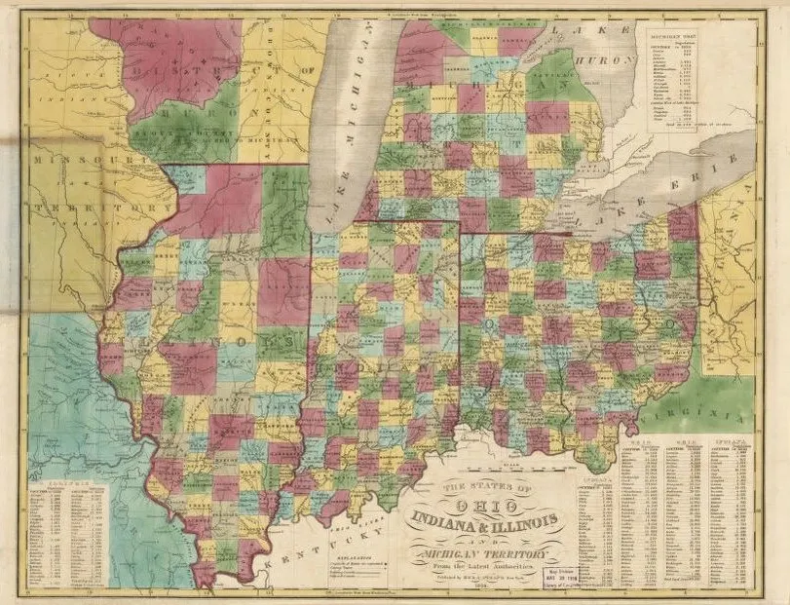
The Northwest Ordinance was very successful and became a model for the settlement of other territories.

